Slide 1
Raising a Well-Rounded, Healthy Child

Slide 3
Look in the mirror
Notes:
Write down three things that your parents did that you felt were counterproductive to your growth and development.
Ask yourself “Are you repeating the same pattern?”
Ham Story

Slide 4
Academic Success
Parents play a very big role in shaping their children’s beliefs and attitudes towards school and schoolwork.
Research has shown that the earlier parents get involved in their child’s educational progress and the more direct this involvement is, the more positive the impact on the child’s academic results and experience of schoolwork. The research also suggests that children with involved parents have:
Higher marks
Better school attendance
Increased motivation
Better self-esteem
Notes:
In the process of trying to help your child achieve academic success we overparent.

Slide 5
Video
https://www.ted.com/talks/Julie_lythcott_haims_how_to_raise_successful_kids_without_over_parenting/up-next#t-278200
Notes:
Video clip 55-530

Slide 6
Activity 2: My Child is Special
Write down your child's name
List as many qualities about your child that makes them special and unique.
What are the three most important things that your child needs from you in order to hone their sense of individuality?
Share your response aloud with your neighbor ( if comfortable)
Notes:
Reflection: Does your child know you feel this way about them?

Slide 7
Notes:
Explain Needs in regards to Developmental stages
Define self-actualization ( all a pretty much self explanatory)
How the lack of these needs affects the child in the long run
Examples

Slide 8
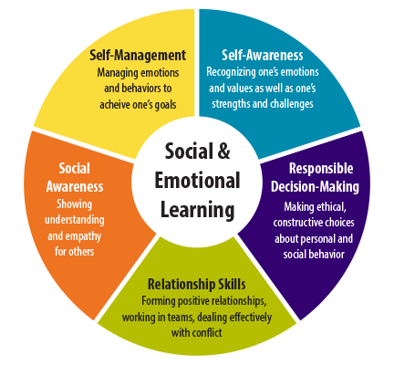

Slide 9
There is no job more important than parenting…
Be sensitive and attuned not reactive.
Be supportive and listen.
Encourage all types of communication
Be consistent, dedicated and patient in all aspects.
Emphasize areas of strength to increase your child's confidence.
Build resiliency– allowing one to make mistakes and learn from them.
Spend quality time– dinner, movie night, bedtime etc.
Teach responsibility from early on-- they're never too young for chores.
Exposing your children to creative arts: ie. Karate, dance, culinary, sports etc. will help them to realize their potential.
Allow them to dream big while discussing the expectations and challenges
Let them take risk– it builds independence and mindfulness
Be affectionate- surround your child with love and happiness

Slide 10
The role of a child…
IS TO BE A KID!!
Explore the environment
Build social skills- playing with other children, developing healthy relationships
Make inferences and observations
Learn independence– form their own identity
Communication– verbal and nonverbal

Slide 11
Video
https://www.ted.com/talks/Julie_lythcott_haims_how_to_raise_successful_kids_without_over_parenting/up-next#t-278200
Notes:
Video clip 10:08- 12:50/14:17

Slide 12
The real truth
Respect your child's decisions, feelings, thoughts, opinions.
[Parents] Self care is important!
Mistakes are inevitable for both parent and child
You are your child's first role model- both good and bad habits
Disappointments are a part of life
The way you speak to your child becomes their inner voice.
Saying “No” is OK.
Accept your child for who they are – not who you want them to be.
Celebrate your child's achievements and milestones as individuals rather than comparing them as a group.
Set attainable expectations for your children
Nurture your children you cant give them too much love and understanding
Praise them for their effort– and let them know they’re valued

